Slide 1
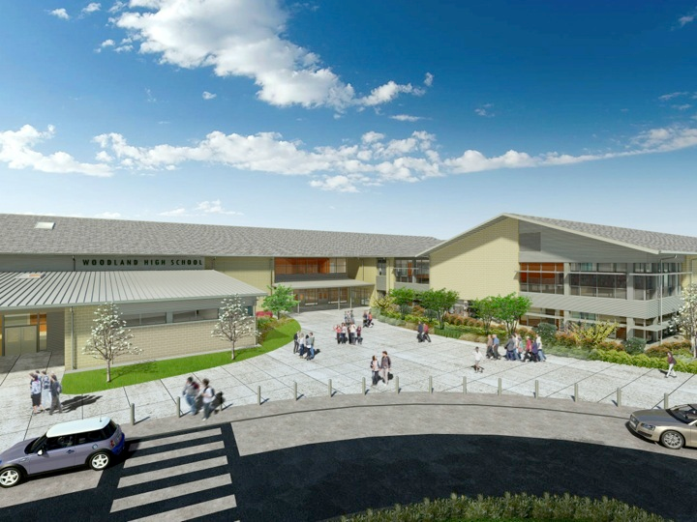
Woodland Public Schools
Facilities Report November
2023

Slide 2
Facilities Report
Budget Cut Impacts – Our Facilities Department has been navigating the loss of 5 custodians due to the levy failure. This has presented quite a challenge trying to provide clean schools for our students and staff. By adjusting schedules and runs, we have given our staff guidelines to complete daily priorities within our restrictions. We also are being supported by the building staff with them taking on minor responsibilities and being understanding of the overall level of cleanliness of our buildings not being what it once was. This has been a challenging time for our facilities team, but we are adjusting and trying to pace ourselves appropriately and not suffer burnout.
Middle School HVAC Upgrades – This project is running behind schedule. Trane of Oregon made some mistakes in their estimation process and ran into some installation configuration issues. Seven of the new heat pump systems require four refrigerant lines, while the old systems only required two. This has set back the project for some reengineering and additional supplies and labor. The cost for these oversights are being covered by the contractor, Trane of Oregon. All ventilation systems and classroom furnaces are installed and working. The estimated completion date is now around the new year.
LED Lighting Upgrades – We are starting the process to transition away from conventional T8 Fluorescent lighting in our schools. The lifecycle, cost savings and environmental impacts make this necessary for us to make the change. This will be a slow process due to our current budget. We are looking at utility incentives, rebates, and grants to help fund this transition.

Slide 3
Facilities Report Cont.
Columbia Elementary – We installed all new LED emergency lighting in the main gym and the upper mezzanine. We recently had a power outage and found the outdated emergency lighting was not adequate and not working in some areas.
New Work Order System – We were using an outside vendor to support and host a work order system at the cost of $5,000.00 annually. We moved to a new scheduling system that is hosted on our District website at no additional cost, saving us the annual fee.

